Slide 1
Adapter Design Pattern
An in-depth analysis
by Sajjad Patel

Slide 2
Contents
Pattern Overview
What Is An Adapter Design Pattern
When Is It Appropriate To Use
How I am going To Go About Using It
Code Example
Similar Patterns
References

Slide 3
Pattern Overview

Slide 4
Pattern Overview
Pattern Name
Adapter
Other Names
Wrapper
Classification
Class and Object Structural
Intent
Converts the interface of one class into the interface a client expects. Allows classes which normally have incompatible interfaces to work with each other

Slide 5
What Is An Adapter

Slide 6
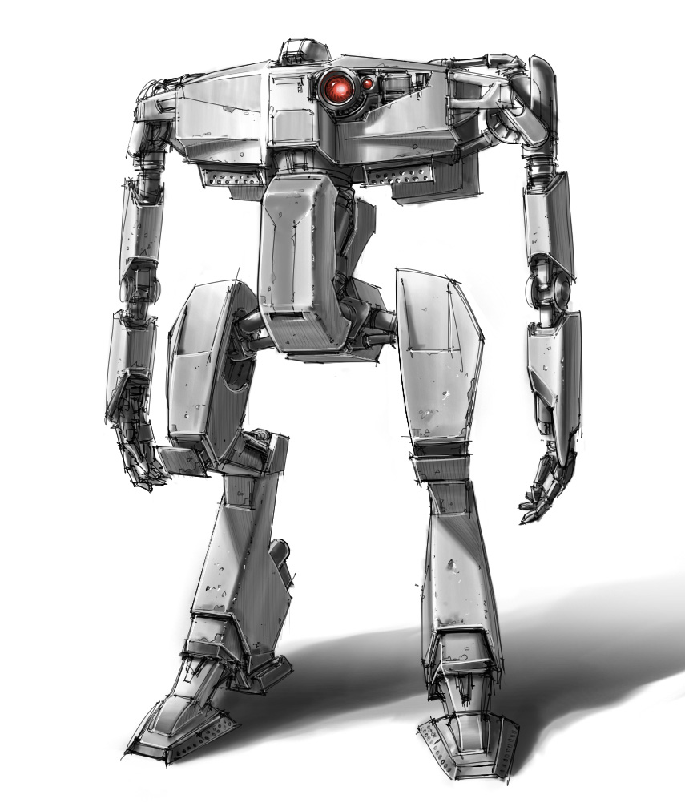
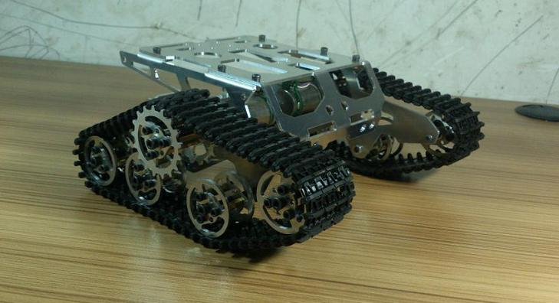
What Is An Adapter Design Pattern
Enemy Tank
Enemy Robot

Slide 7
What Is An Adapter Pattern
Tank
Fires a weapon
Drives forward
Has someone driving it
Enemy Robot
Smashes enemy
Walks forward
Reacts to a human

Slide 8
When Is It Appropriate To Use

Slide 9
When Is It Appropriate To Use
When you have two objects that do everything similar
For Example
They both attack
They both move forward
They both interact with humans
When one object has a special functionality which the other doesn’t have

Slide 10
How I am going To Go About Using It

Slide 11
How I am going To Go About Using It
UML Diagram
Interface
Enemy Tank
Enemy Robot
Adapter
Main
Output

Slide 12
Code Example

Slide 13
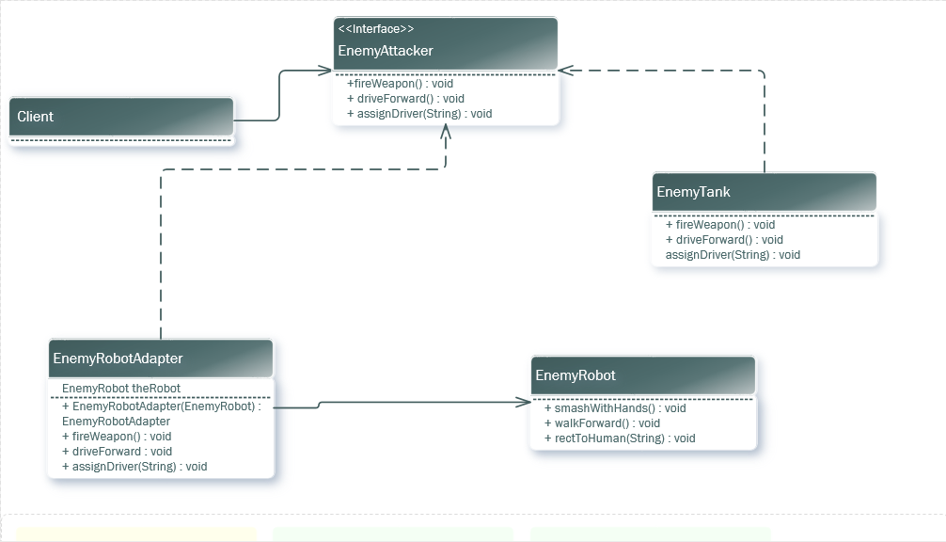
Code Example

Slide 14
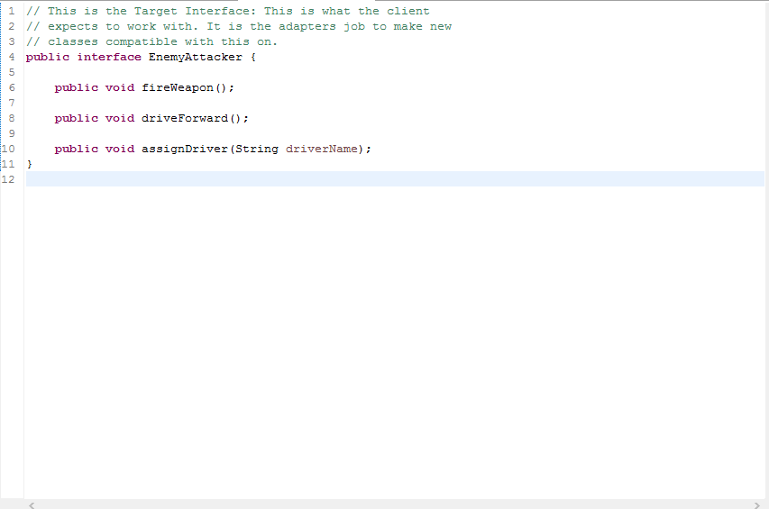
Code Example

Slide 15
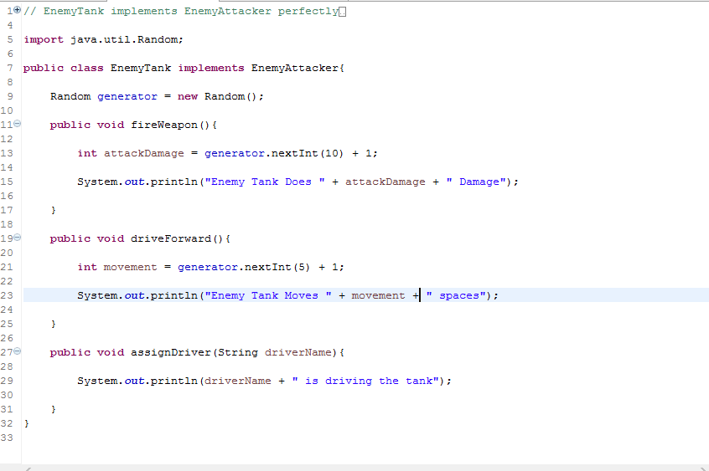
Code Example

Slide 16
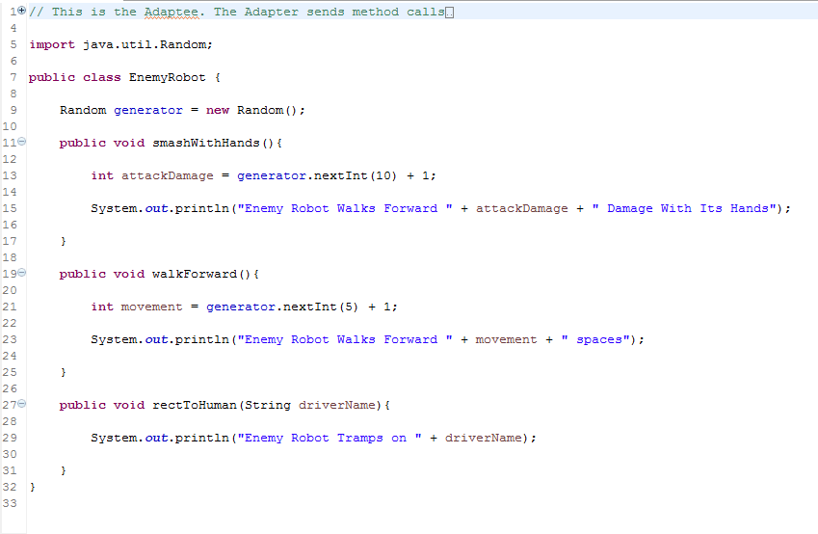
Code Example

Slide 17
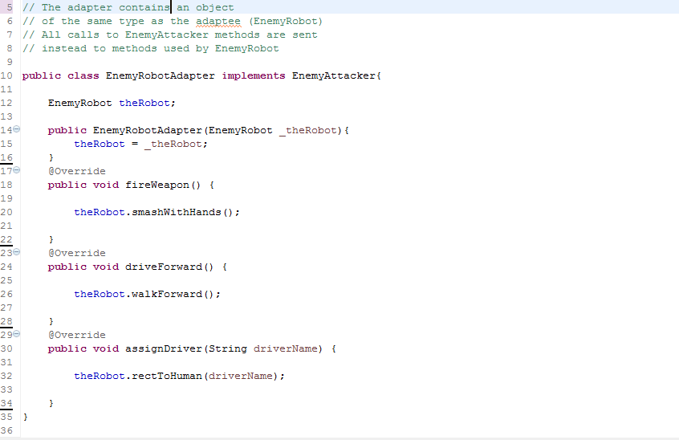
Code Example

Slide 18
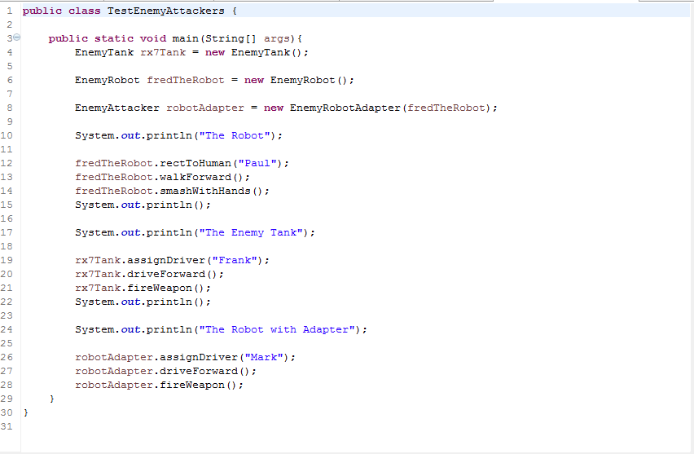
Code Example

Slide 19
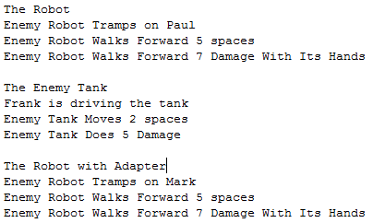
Code Example

Slide 20
Similar Patterns

Slide 21
Similar Patterns
Bridge
A Bridge separates an interface from its implementation so that it can be varied easily and independently
Decorator
It enhances objects without changing its interface
Proxy
Defines a representative for another object without changing its interface

Slide 22
References

Slide 23
References
http://www.robotstorehk.com/metallic/images/Tank-9/TB2.T1IaVXXXXX_XXXXXXXXXXXX-544675804.jpg
http://media1.gameinformer.com/imagefeed/featured/2kgames/borderlands/borderlands2/guidedtour/large/battlebot_07.jpg
http://www.newthinktank.com/2012/09/adapter-design-pattern-tutorial/
https://cathyatseneca.gitbooks.io/design-patterns-in-uml/content/adapter.html

Slide 24

Questions?

